Slide 1
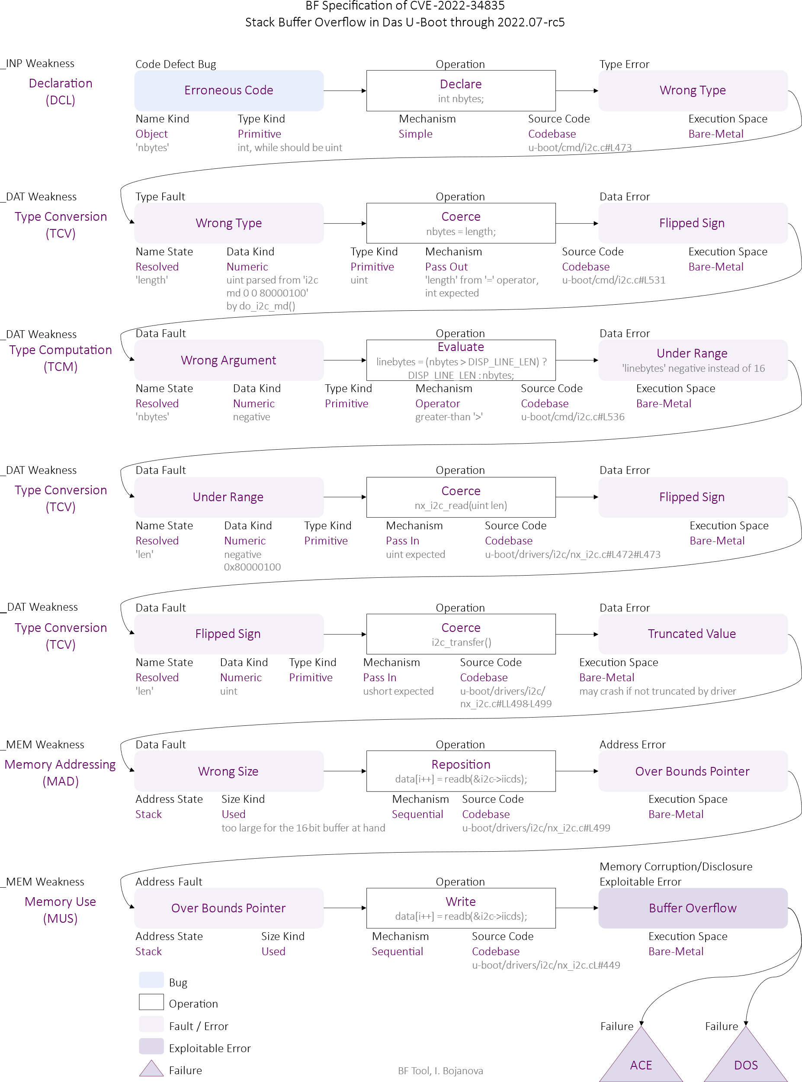

ITL Science Day
Labeling Software Security Vulnerabilities
Irena Bojanova, NIST; John Guerrerio, Dartmouth College; Eduard Pinconschi, University of Porto
Motivation
Crucial need for systematic comprehensive labeling of the more than 228 000 publicly disclosed cybersecurity CVE vulnerabilities to enable advances in modern AI cybersecurity research.
Objective
Utilize the Bugs Framework (BF) formalism for BF-CWE-CVE mappings.
BF Labels for CVEs
Bugs Framework (BF) allows formal unambiguous specification of CVE vulnerabilities
BF’s rich, precise, unambiguous set of tokens for types and values of bugs, faults, errors, weaknesses, etc. can be used as comprehensive AI labels without additional processing – e.g., the BF CVE-2023-38435 specification’s value labels (in purple) and type labels (in black):
CWE Labels for CVEs
NVD, with input from security community, labels CVEs with CWEs
Challenging, as CWEs can be too specific, ambiguous, or overlapping – e.g., CVE-2023-38435 is labeled CWE-787, while CWE-121 (Stack-based Buffer Overflow) fits it better
As AI labels, CWEs require extra processing of their unstructured textual information to determine causes, operations, consequences, attributes, and their types, if possible at all.
CWE2BF & CVEs Pre-Annotation
BF's formalism allows specifying each CWE as a (cause, operation, consequence) weakness triple or a chain of such weakness triples
We focus on the 60 memory-related CWEs, as a vast number of memory-related CVEs (approx. 61 000) are mapped to them – 48 distinct BF weaknesses or chains of weaknesses
7 CWEs share a BF causing chain with other CWEs – e.g.,
11 groups of CWEs map to the same BF weakness triple(s) – e.g.,
CWE2BF mappings at least partially fit many CVEs and can aid in their annotation
CWEs’ main weaknesses are mostly correct by operation and final error
CWEs’ identifiable causing weaknesses can be overly specific and sporadic – e.g., CVE-2023-38435’s cause is Erroneous Declare followed by other type-related weaknesses, while its assigned CWE-787 lists only Erroneous Calculate as a causing weakness
CWEs not assigned to any CVEs, may fit better than the assigned CWEs with identical BF triple(s), which is indicative of ambiguity – e.g., CVE-2023-38434 is mapped to CWE-415 (memory-related double free) but better fits CWE-1341 (multiple releases of same resource).
CWE-127 CWE-786 CWE-124 | (Erroneous Code, Calculate, Wrong Result) ↪ ↪ Wrong Index, Reposition, Under Bounds Pointer) | (Under Bounds Pointer, Read, Buffer Under-Read) (Under Bounds Pointer, Read/ Write, Buffer Underflow/ Buffer Under-Read) (Under Bounds Pointer, Write, Buffer Underflow)
CWE-415 CWE-1341 | (Erroneous Code, Deallocate, Double Free)
Potential Impact
Comprehensively labeled BF CVE datasets for cybersecurity research, education, and guidance
CWE2BF specifications for use in software testing tool reports.
10/5/2023
The Bugs Framework (BF) https://usnistgov.github.io/BF/
BF, I. Bojanova, since 2014

